Slide 1
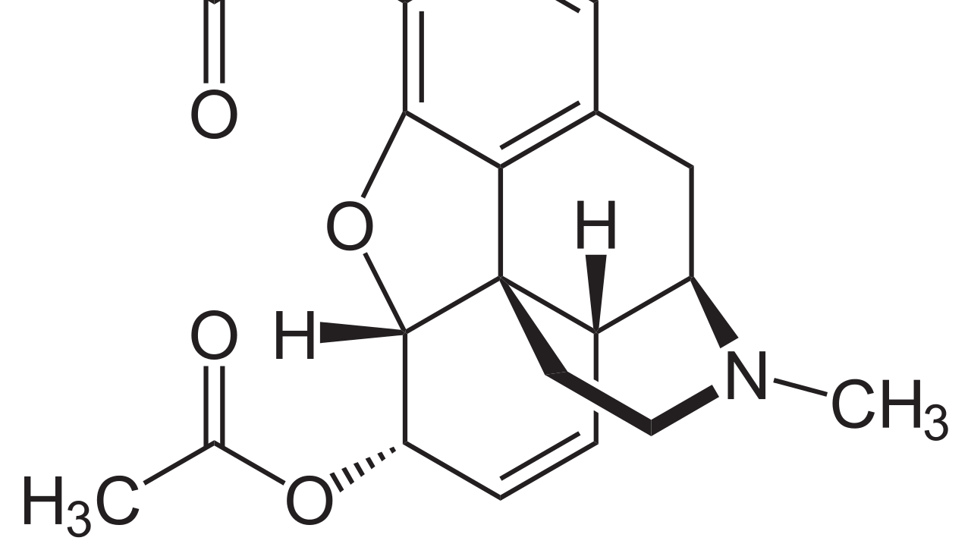
Heroin Research
By Quang Huynh

Slide 2
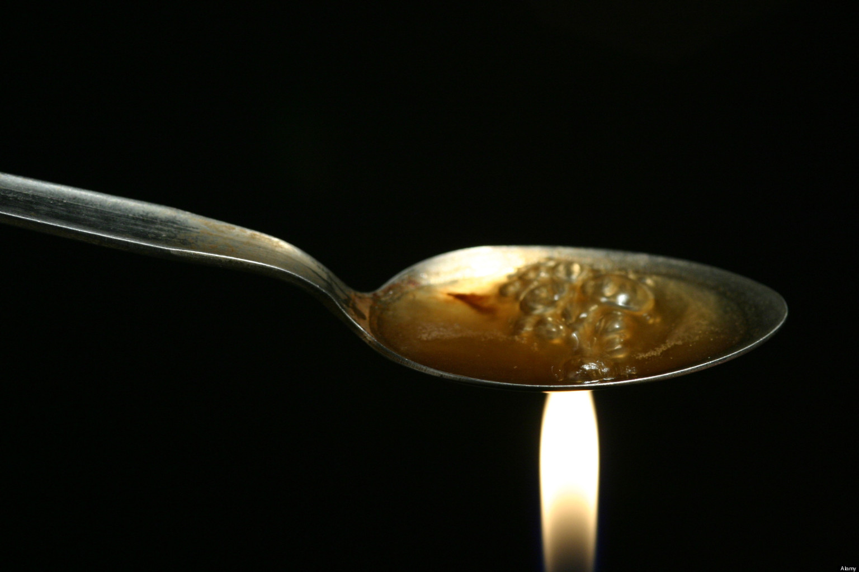
How many lives have been lost due to heroin overdoses?
As of 2016, 15,469 deaths have been caused by heroin overdoses.

Slide 3

How many emergency room visits are attributed to heroin abuse?
According to an article made in 2009, 213,118 Emergency Room Visits are attributed to heroin.

Slide 4

How many people are incarcerated because of this illegal drug?
In an article, it says heroin causes 6% of Federal Prison sentences.

Slide 5

How many young people have reported trying heroin at least once?
According to an article, it states that more than 948,000 young people have tried heroin at least once.

Slide 6
In an article that I have read, the data included that 20% of heroin addicts recover and live on to have a successful life.
How many people bounce back from heroin addiction and still live on to be successful?

Slide 7
Summary
This is my heroin research. So, in

